Slide 1
Urban Technology
- (Analysis of Mass shooting
in US)
02.02.2023
Hasan Anwar

Slide 2
1: Dataset
Mass Shootings in the United States of America (1966-2017) - Kaggle
The dataset covers a 50-year time period from 1966 to 2017 and includes information on 398 mass shootings in the United States.
The data includes variables such as location, date, number of fatalities and injuries, information on the shooter, and more.
The mass shootings in the dataset resulted in a total of 1,996 deaths and 2,488 injuries.

Slide 3
2: Questions
Which state has the highest number of victims and distribution of fatalities/Injured
Distribution of shooting by shooter’s race and gender
Is there any specific day in a week where crimes takes place?
In a general examination, was the site of the shooting episode established to be open or closed at the time of the incident?
Top 5 cause of shooting / Mental Health Issues

Slide 4
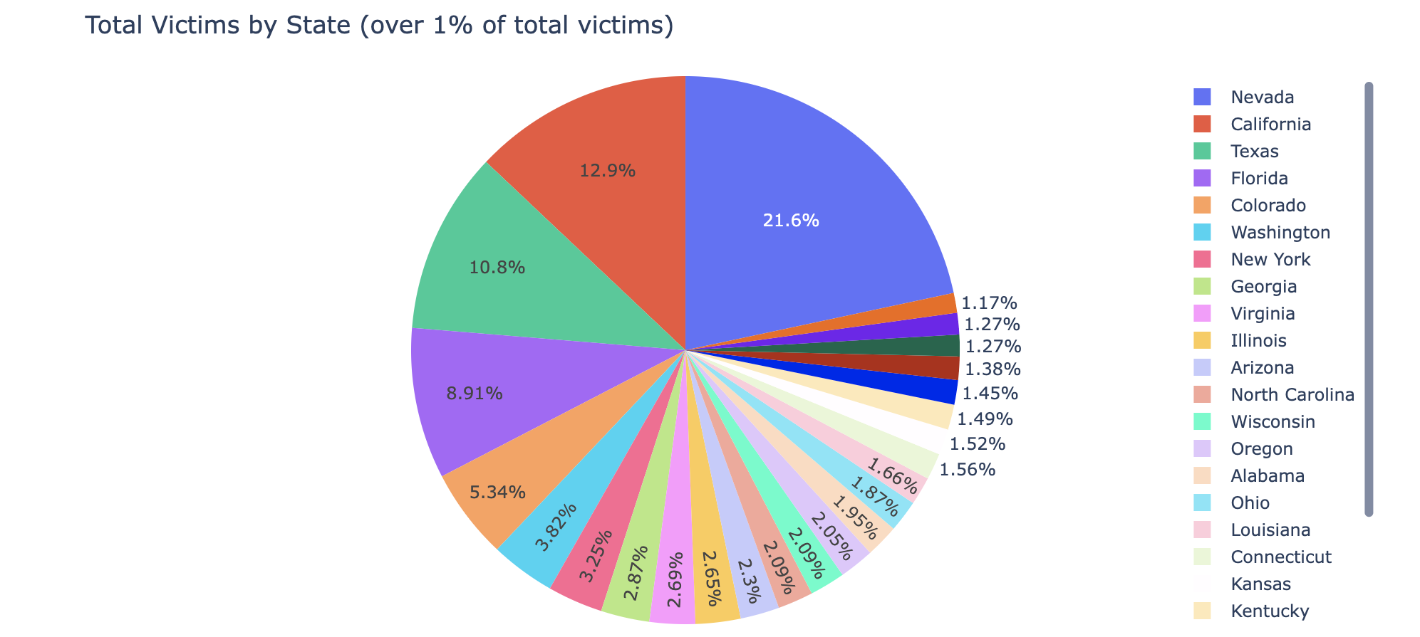
3: Which state has the highest number of victims and distribution of fatalities/Injured

Slide 5
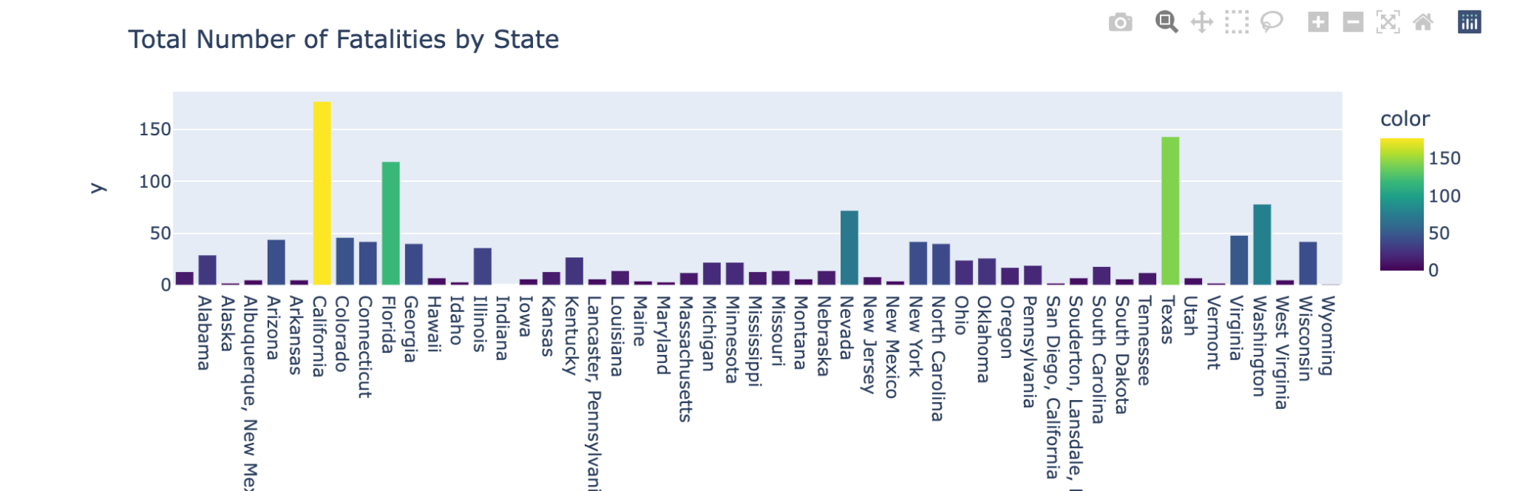
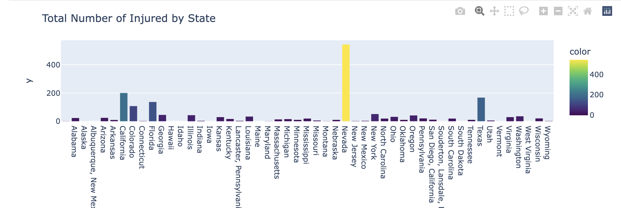

Slide 6
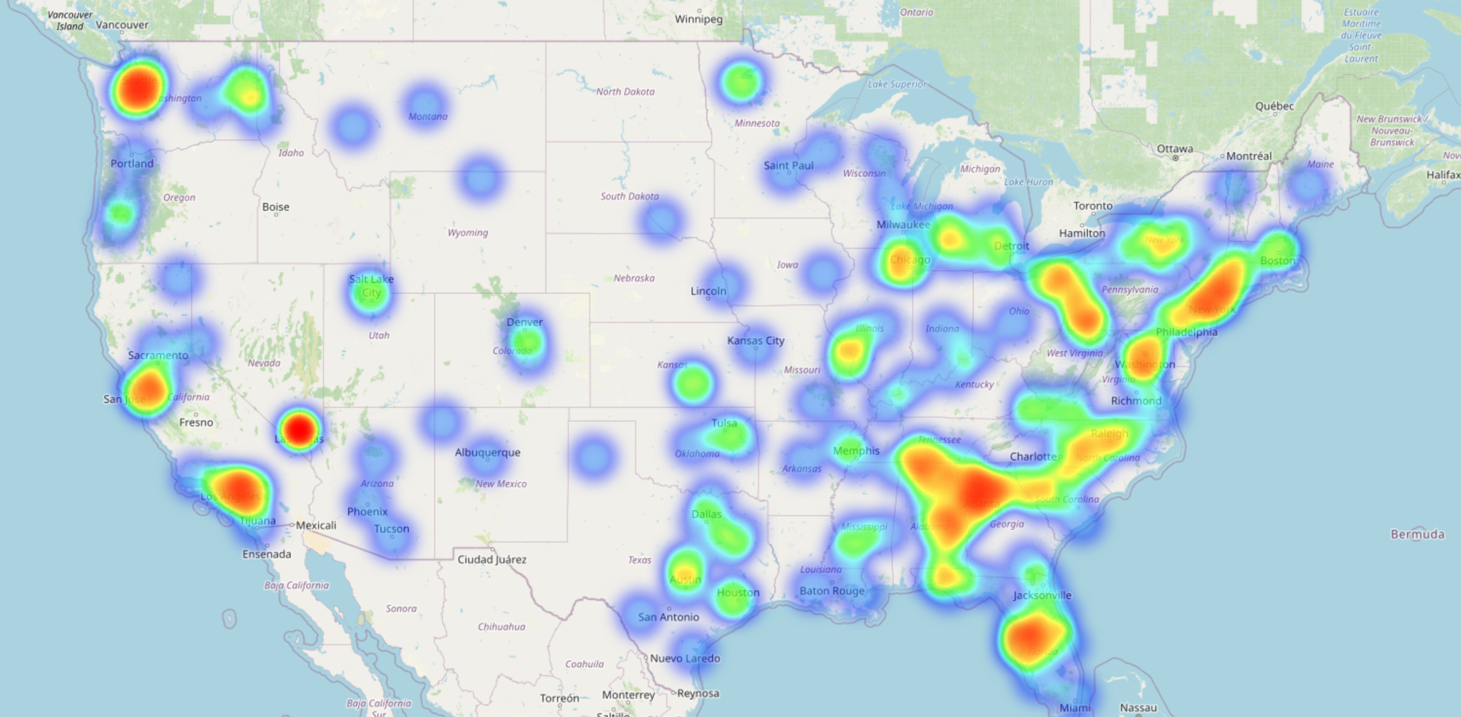

Slide 7
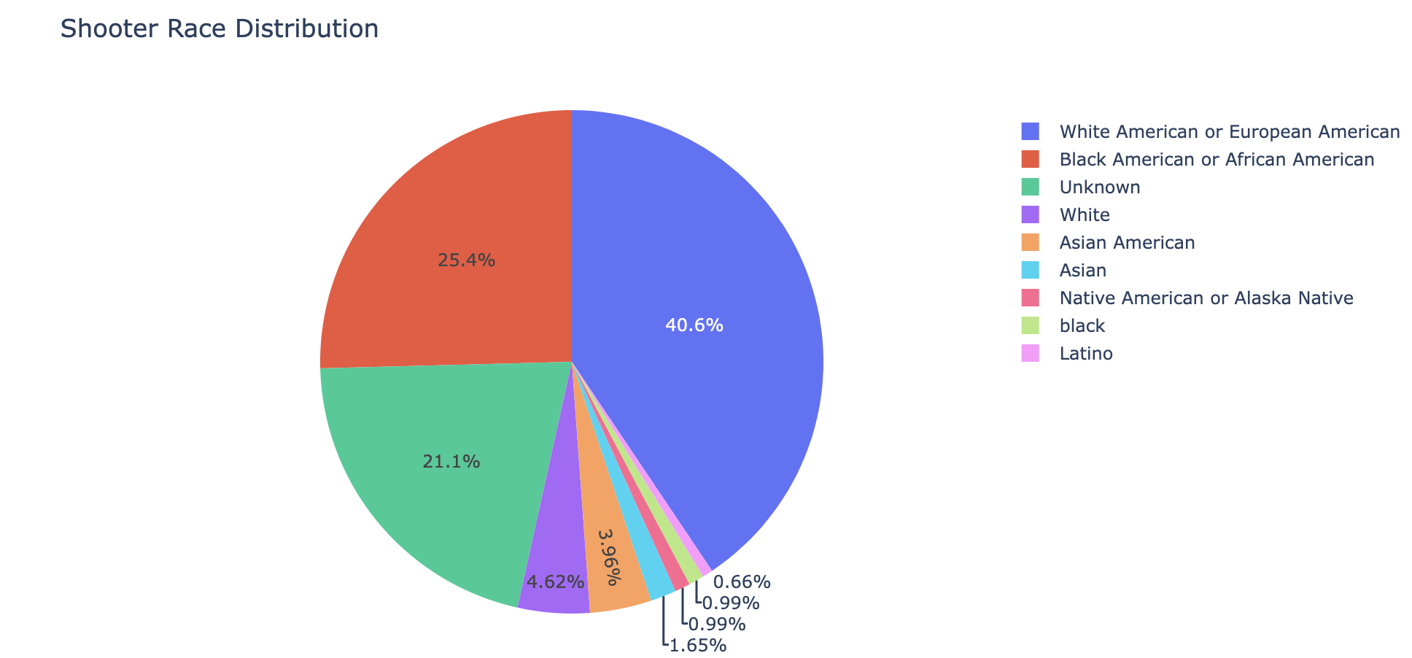
4: Distribution of shooting by shooter’s race and gender

Slide 8
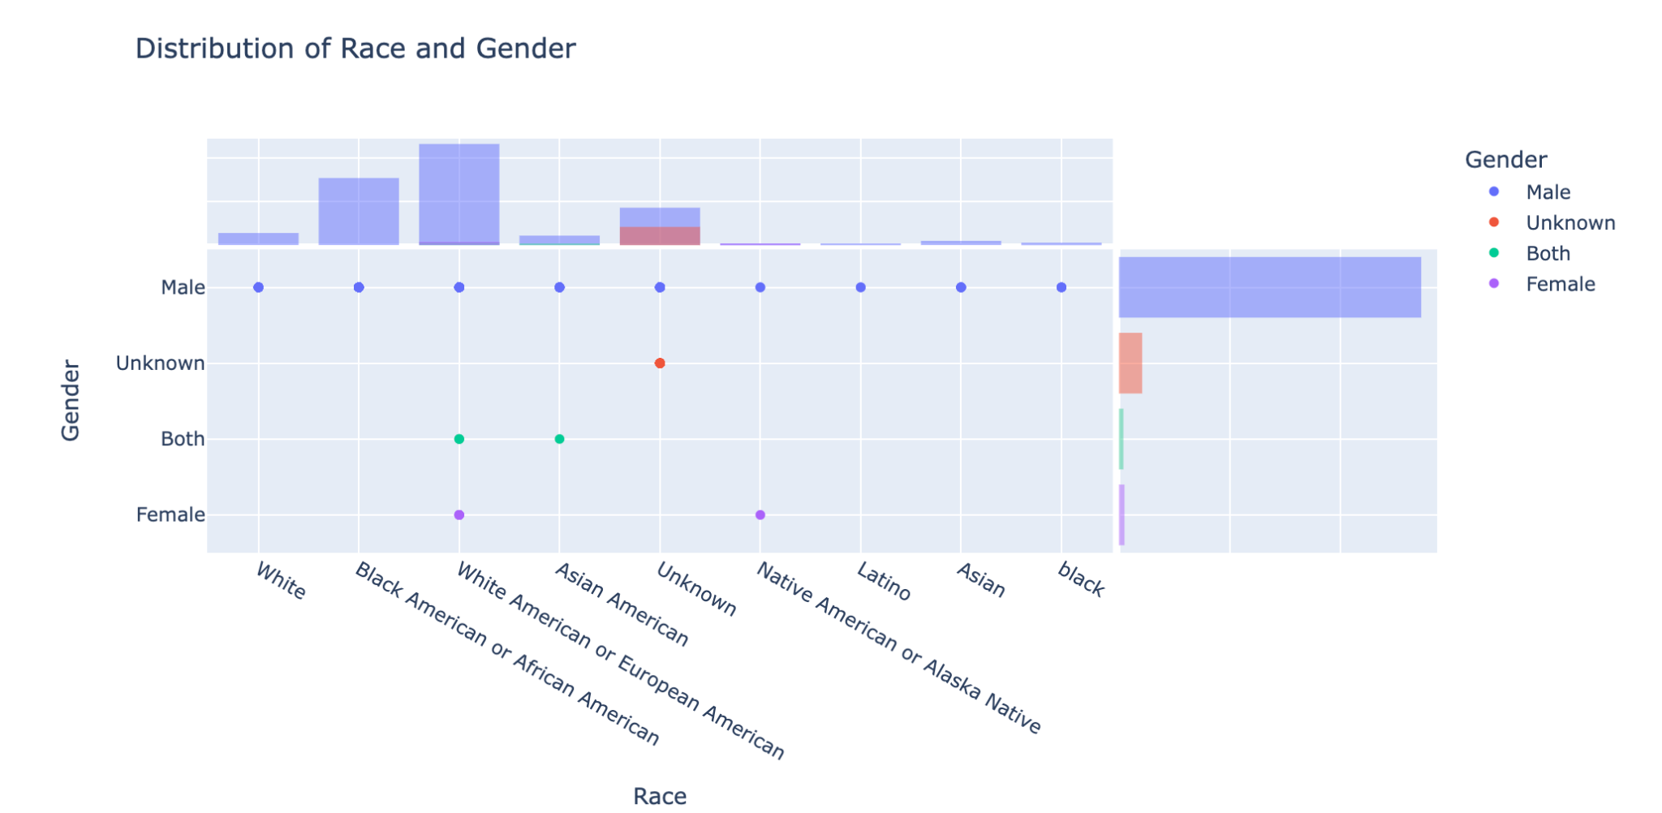

Slide 9
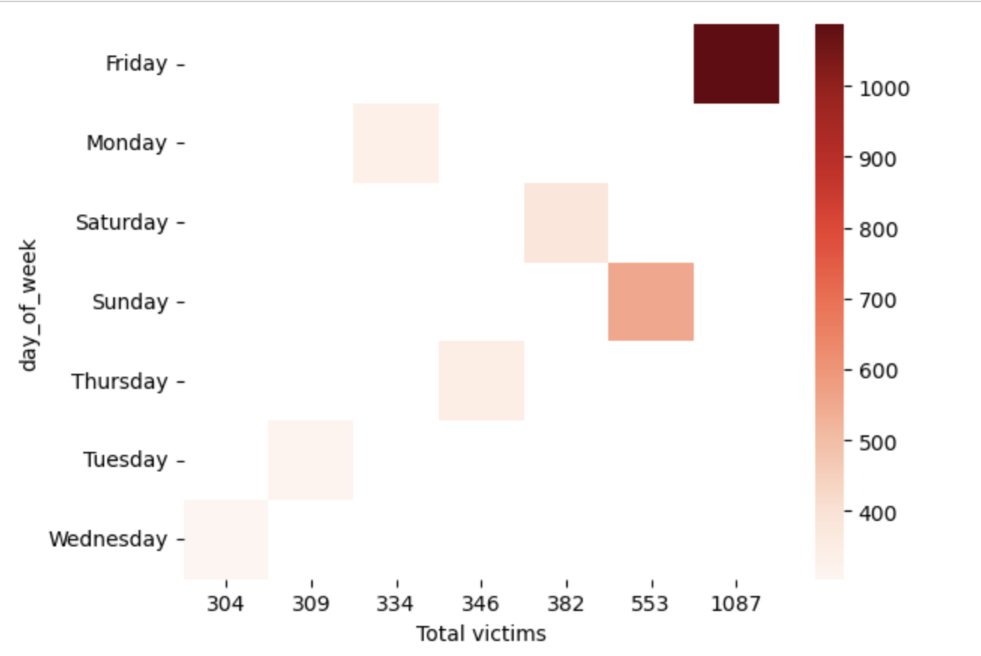
5: On which day of the week do incidents of criminal activity occur with the greatest frequency?

Slide 10
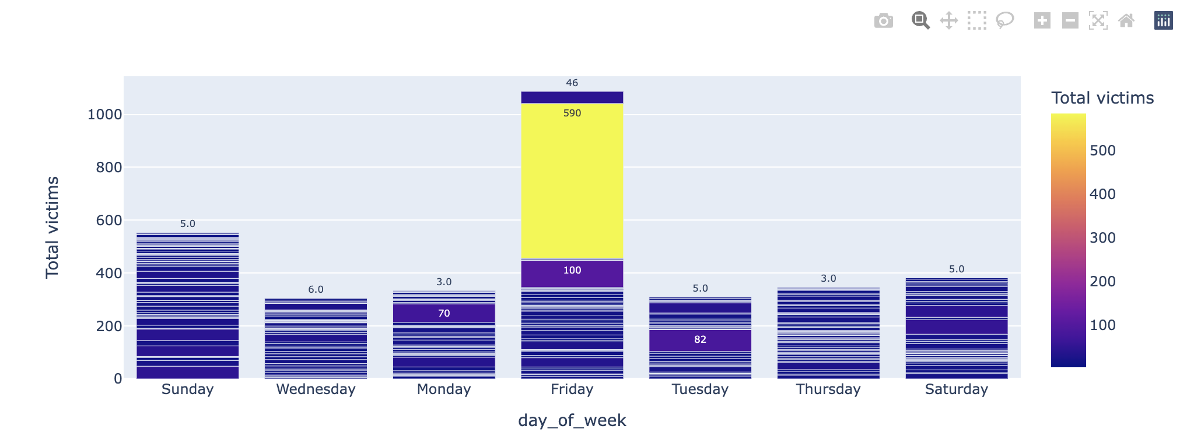

Slide 11
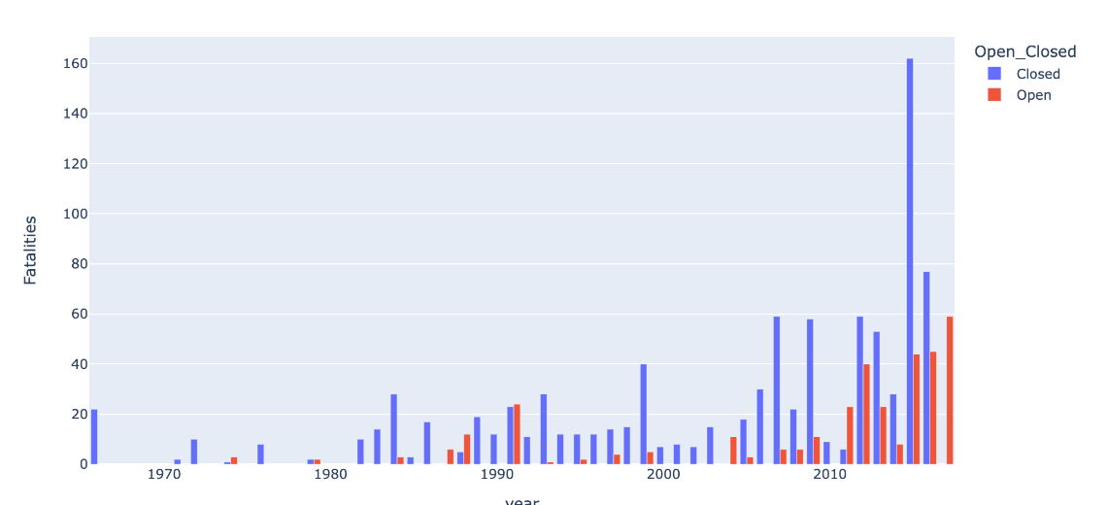
6: In a general examination, was the site of the shooting episode established to be open or closed at the time of the incident / Ratio of Fatalities vs Injured?

Slide 12
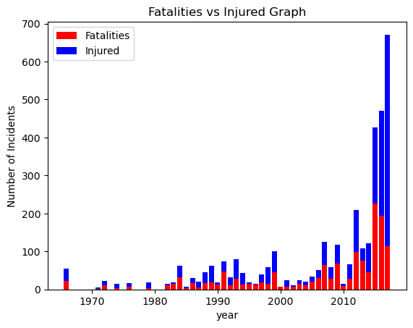

Slide 13
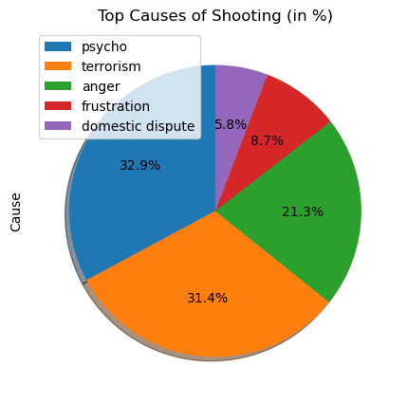
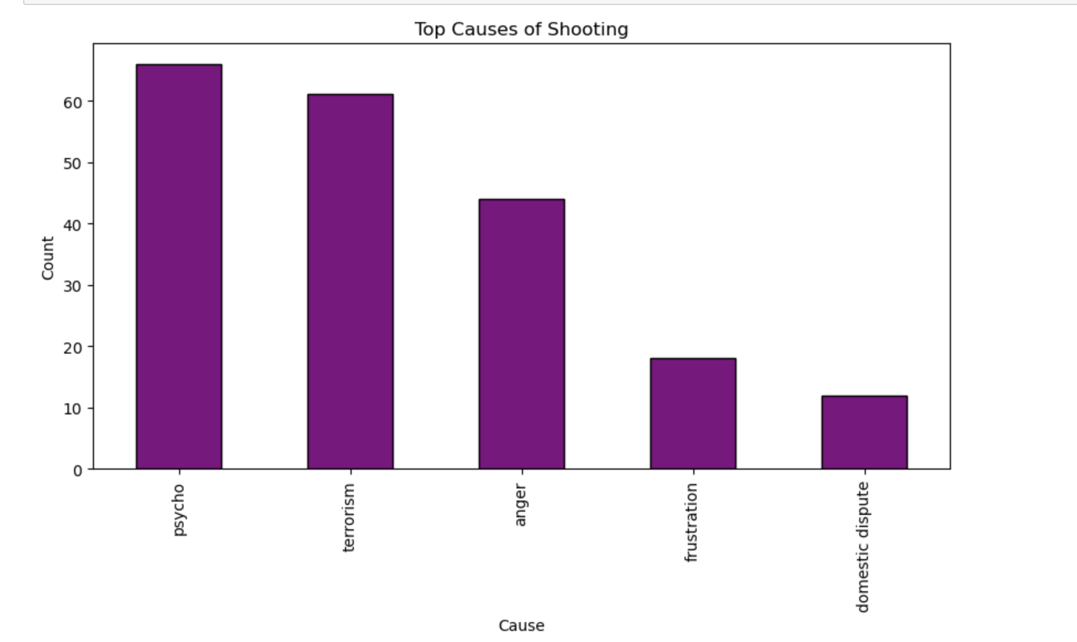
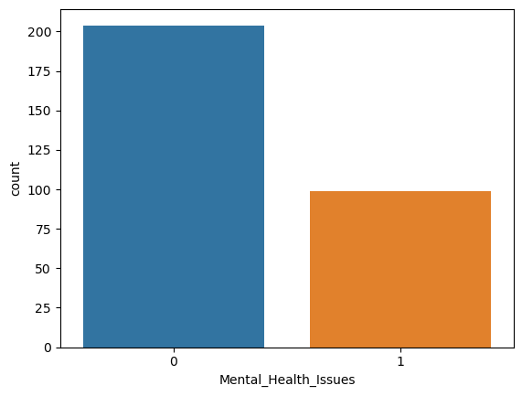
7: Top causes of shooting / Mental Health issues

Slide 14
8: Sentiment Analysis / Tokenization
Sentiment Analysis
Negative 177
Positive 78
Neutral 68
Tokenization:
Shot - 174
Killed - 168
Shooting - 113
Shooter - 115
Man - 108
Police - 99

Slide 15
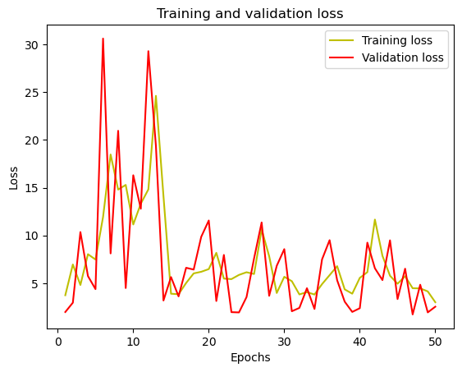
9: ML Model (NN)

Slide 16
Thank you!

